Slide 1
All About Me - April 2025
Name:
Date starting setting:

Slide 2
This is me!
My name is…………………………………..
I like people to call me……………………
I was born on……………………………….
Things people admire about me…
My favourite things are…
How I might communicate with you…

Slide 3
This space is for drawing, writing or photos I want to share with you about me.

Slide 4
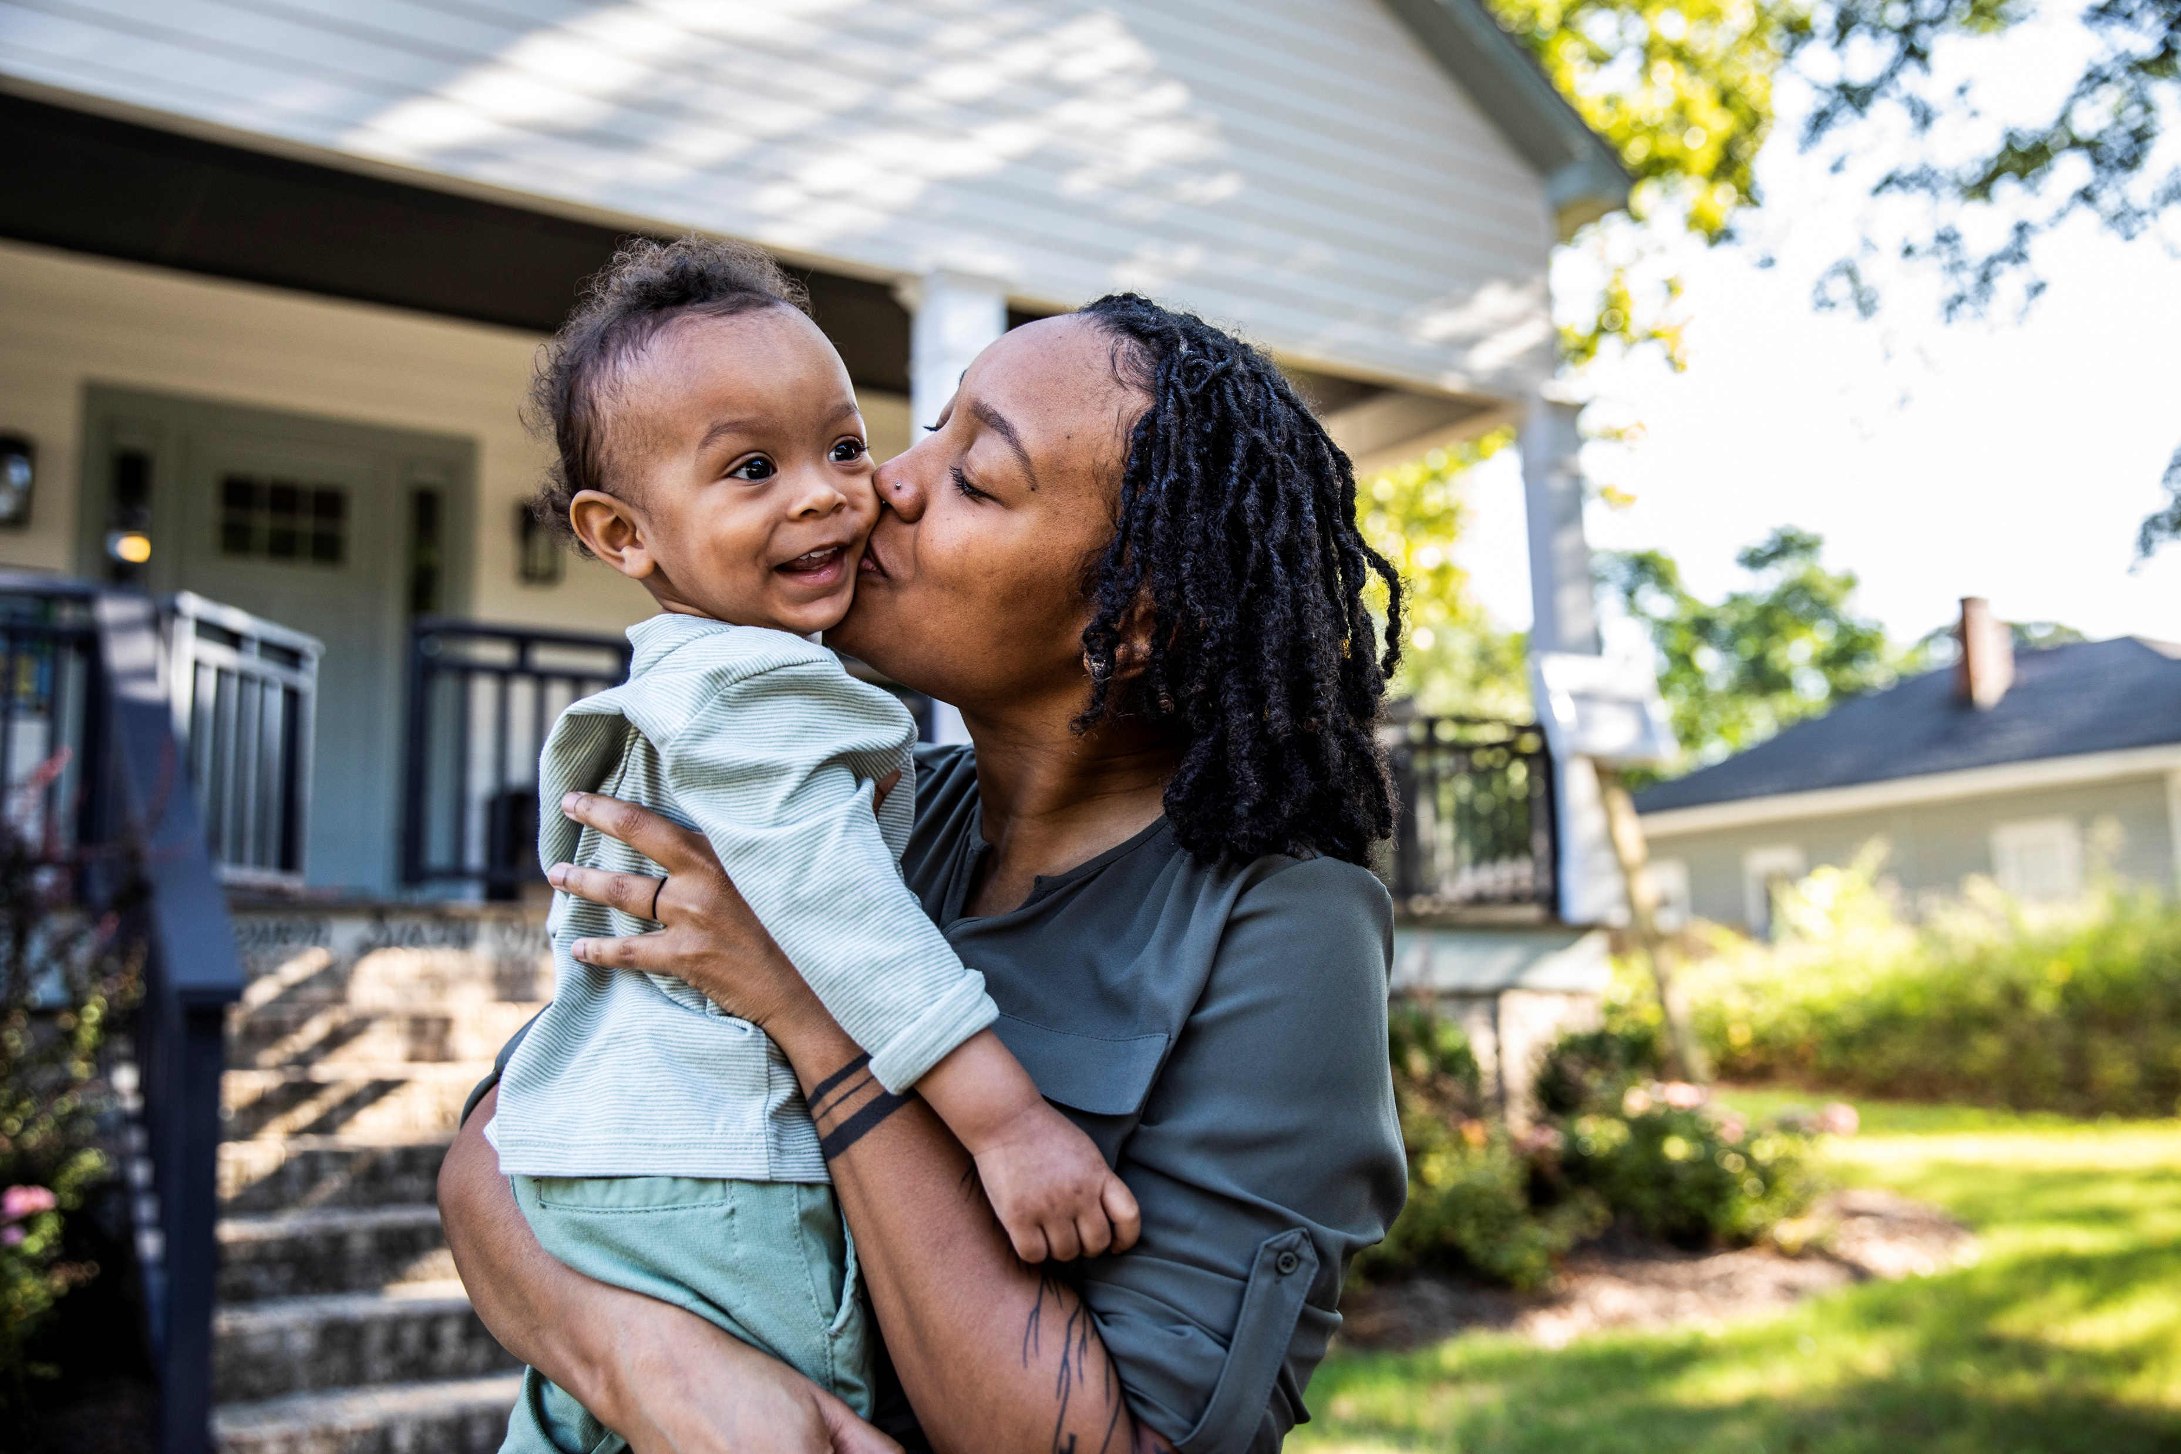
Relationships
The people in my world
Other people in my family are……
My friends are……
Other people who are important to me……

Slide 5
This space is for drawing, writing or photos I want to share with you about my family.

Slide 6
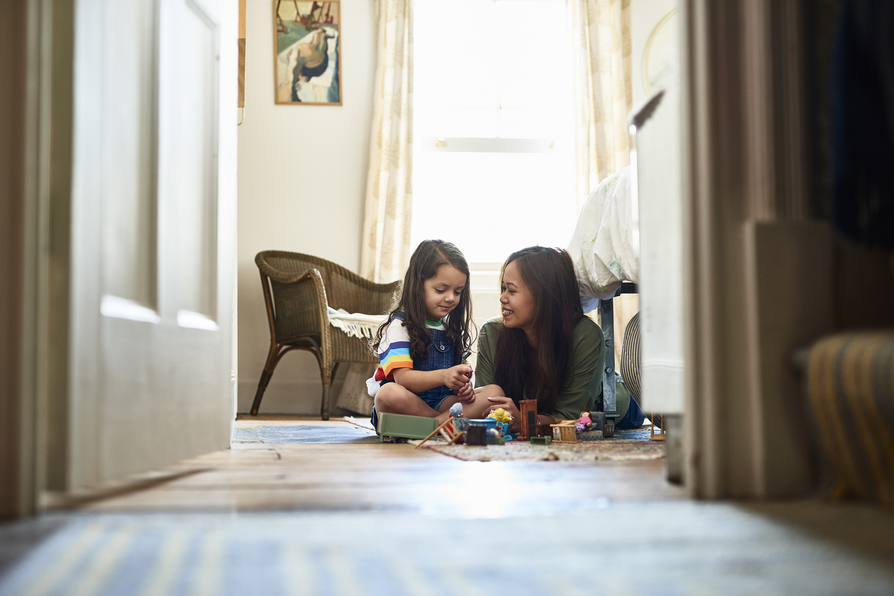
My Home
My safe space
People I live with……
My favourite thing to do at home……
Family pets……

Slide 7
My learning
Play, creativity and Curiosity
I love to play with……
My favourite books or tv shows are……
I am really good at……
I am working on…..

Slide 8
My Communication
How I interact with you
I communicate by…..
When I am happy, other people will know because I……
When I am sad, other people will know because I……

Slide 9
My Emotions
How I interact with you
Things that me me happy or excited…..
When I am happy or excited you will see me doing…..
Things that me sad or angry…..
When I am sad or angry, you will see me doing…..

Slide 10
My Health
To keep me healthy
Please add information relating to medication, allergies, risk assessment, health care plans, toileting routines etc
To keep me healthy I need…..
Things I need help with…..
Things I can do on my own…..
Important information you need to know…..

Slide 11
This booklet will help adults in my setting get to know me.
Use this information to plan fun experiences and meet my needs.
Complete alongside parents to help with my transition

Slide 12
Additional pages
Please use additional pages where relevant
‘All About Me’ must be reviewed at regular intervals, in particular during transitions

Slide 13
Starting Early Years Setting Checklist for practitioners
Tick when complete
Registration forms complete
Policies and procedures shared
Home visit arranged
All about me sent home for parent contribution
Arrange visits
Share photos of setting
Additional information when relevant
Complete Multi-Agency records to understand support in place, i.e. professional reports
Agree transition meeting with parent and SENCO to review ‘All about me’ together
Share ‘One Page Profile’ and Starting setting social story
Discuss Individual Support Plan needs

Slide 14
Transition to Early Years Setting Visits
Home Visit on:
Transition Meeting arranged for:
I will visit my setting on:
Important information you need to know…..

Slide 15
Multi agency Record
People who support me | Role/Service | Contact information

Slide 16
Transition to school checklist for practitioners
Tick when complete
Admission application complete on portal
Initial contact with confirmed school
Arrange transition meeting
Review Transition guidance and starting reception advice to support Parents/carers
Review summative assessment with parent and share with teacher
Arrange school visits
Additional information when relevant
Collaborate with parents on SEND Transition Passport
Agree transition meeting with school, parent and SENCO to review Transition Passport
Develop Transition Action Plan if required
Share supportive information such as One Page Profile/Health Care Plan/ Risk Assessment, EHCP or Provision Map
Share multiagency records in line with Berkshire West Safeguarding Children Partnership guidance

Slide 17
Transition to School Visits
Teachers visiting on:
Transition Meeting arranged for:
I will visit my school on:
Important information you need to know…..

